Slide 1
Backend Programming
1 - Introduction to Javascript

Slide 2
References
https://www.w3schools.com/js/
https://developer.mozilla.org/en-US/docs/Learn/Getting_started_with_the_web/JavaScript_basics

Slide 3
Web Browser
Javascript Usage
Server-side or Non-browser Apps

Slide 4



Web Browser
Javascript Usage
Server-side or Non-browser Apps

Slide 5
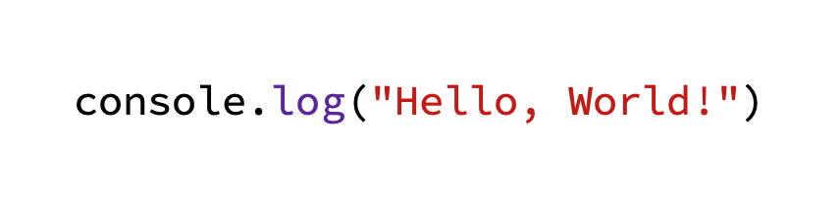
Hello World

Slide 6
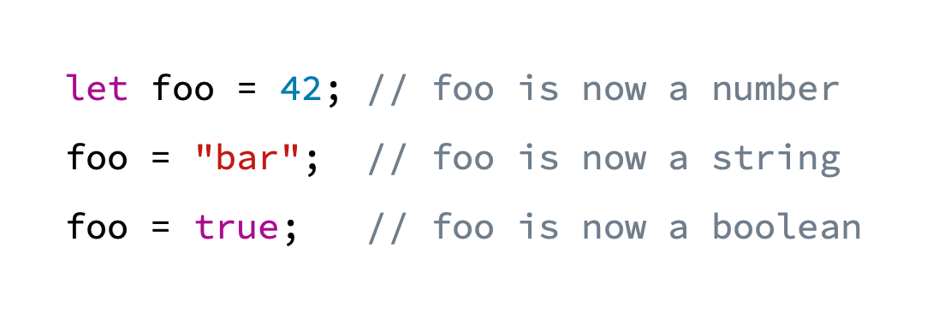
Dynamic Typing
Variables in JavaScript are not directly associated with any particular value type, and any variable can be assigned (and re-assigned) values of all types

Slide 7
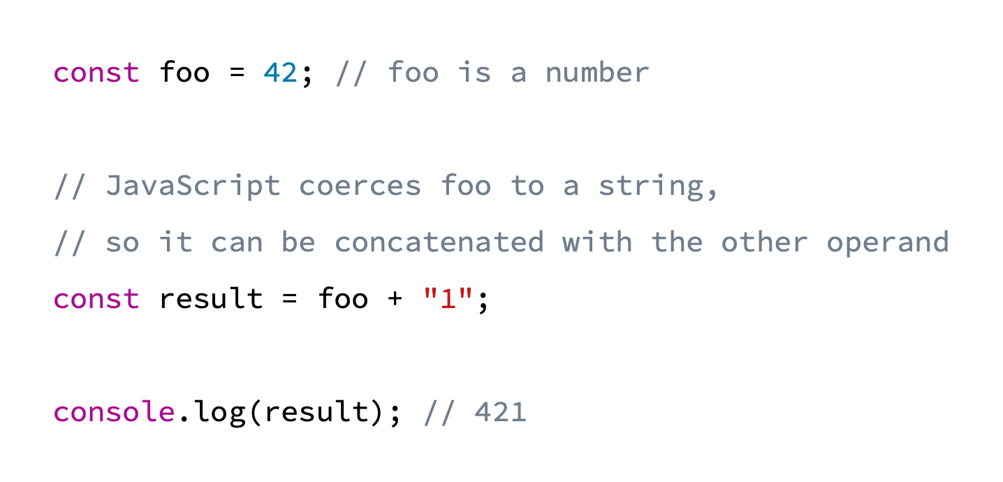
Weak Typing
Javascript allows implicit type conversion when an operation involves mismatched types, instead of throwing type errors.

Slide 8
Primitive Data Types
Null
Undefined
Boolean
Number
BigInt
String

Slide 9
Null Type
The Null type is inhabited by exactly one value: null

Slide 10
Undefined Type
The Undefined type is inhabited by exactly one value: undefined
Conceptually, undefined indicates the absence of a value, while null indicates the absence of an object.
Javascript usually defaults to undefined when something is devoid of a value:
A return statement with no value
Accessing a nonexistent object property
A variable declaration without initialization
Many methods return undefined when no element is found

Slide 11
Boolean Type
Represents a logical entity and is inhabited by two values: true and false

Slide 12
Number Type
A double-precision 64-bit binary format IEEE 754 value.
It is capable of storing floating-point numbers between ±2^(-1074) and ±2^1024.
It can only safely store integers in the range -(2^53 - 1) to 2^53 - 1.
Values outside the range are automatically converted to +Infinity, +0, -Infinity, or -0.
NaN (“Not a Number”) is a special kind of number value that’s typically encountered when the results of an arithmetic operation cannot be expressed as a number.

Slide 13
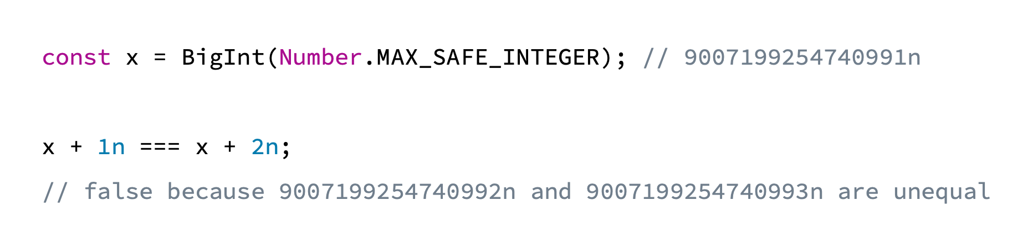
BigInt Type
The BigInt type can represent integers with arbitrary magnitude. It can safely store and operate on large integers even beyond the safe integer limit for Numbers.

Slide 14
String Type
The String type represents textual data and is encoded as a sequence of 16-bit unsigned integer values representing UTF-16 code units.
Each element in the string occupies a position in the string. The first element is at index 0, the next at index 1, and so on.

Slide 15
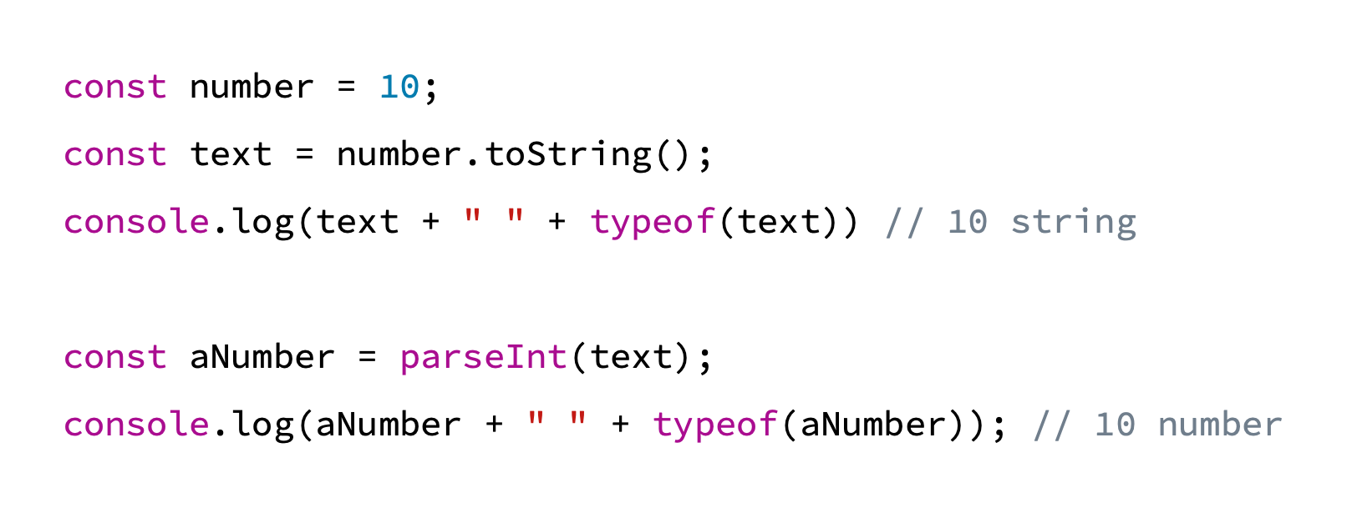
Type Conversion

Slide 16
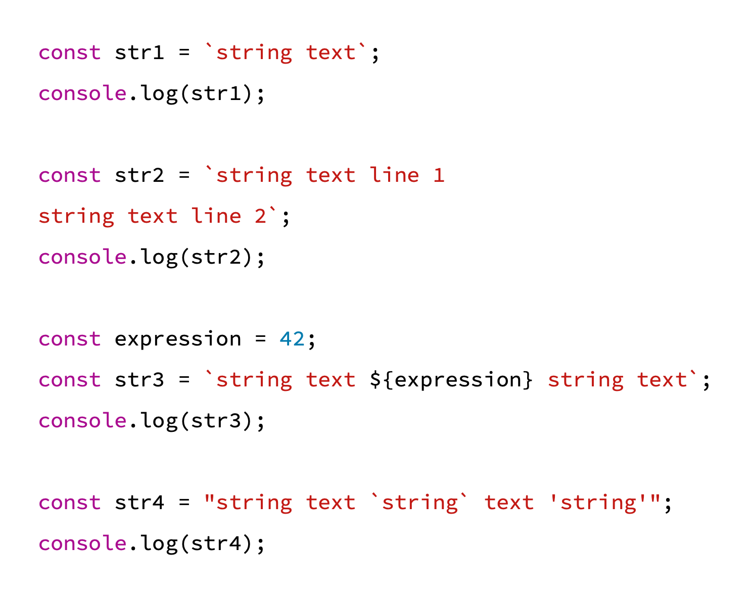
Template Literals

Slide 17
Operators
Comparison operators
== === != !== > >= < <=
Arithmetic operators
+ - * / % ++ -- **
Bitwise operators
& | ^ ~ << >> >>>
Logical operators
&& || !

Slide 18
Equality Comparisons and Sameness
Javascript provides three different value-comparison operations:
=== strict equality (triple equals)
== loose equality (double equals)
Object.is()

Slide 19
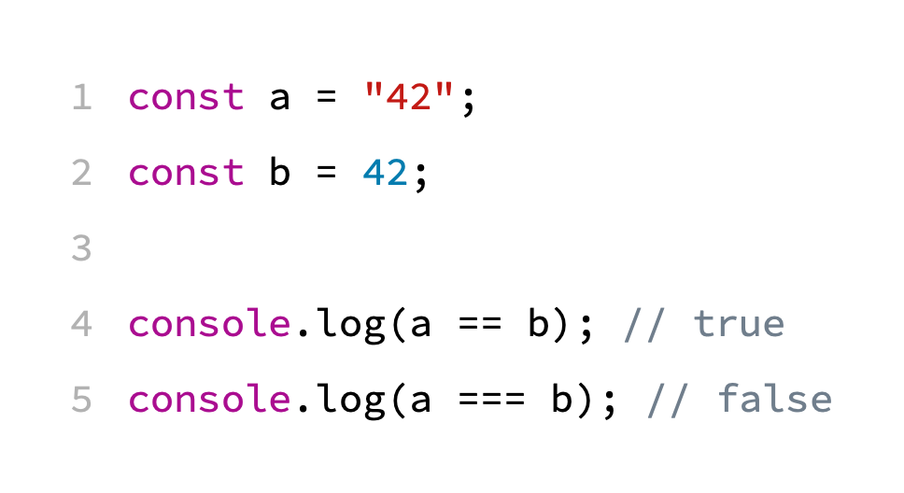

Slide 20
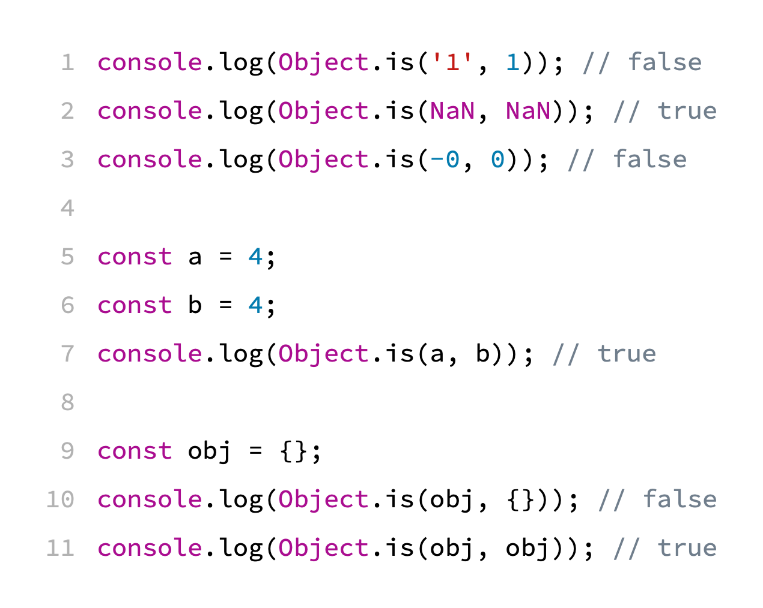
Same-value Equality using Object.is()
Determines whether two values are functionally identical in all contexts.
https://jsfiddle.net/g6vqLf0b/

Slide 21
Comparing Equality Methods
https://developer.mozilla.org/en-US/docs/Web/JavaScript/Equality_comparisons_and_sameness#comparing_equality_methods

Slide 22
Exercise 1
This code does not execute properly. Try to figure out why and fix it.
https://jsfiddle.net/em946pcq/

Slide 23
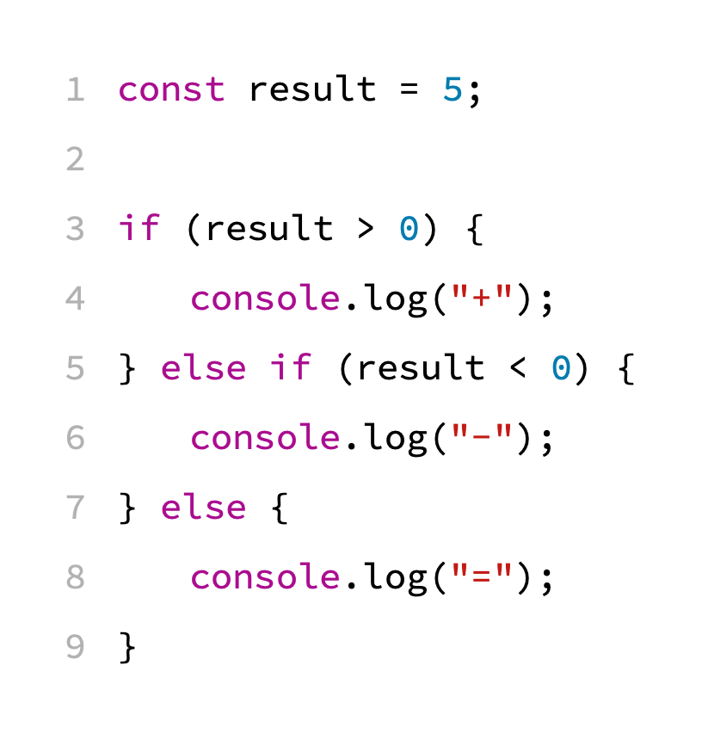
Conditionals: if … else

Slide 24
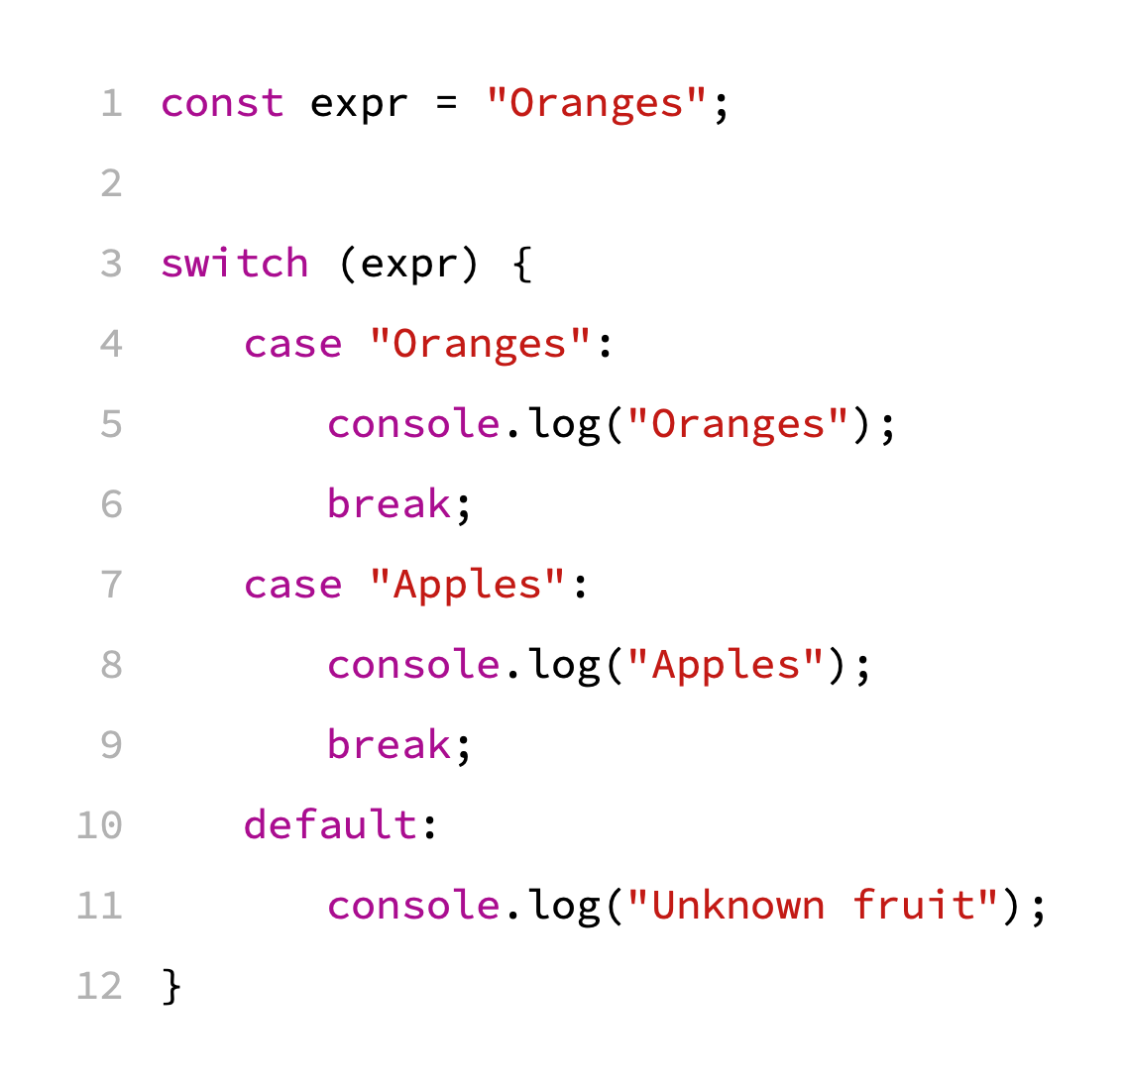
Conditionals: switch

Slide 25
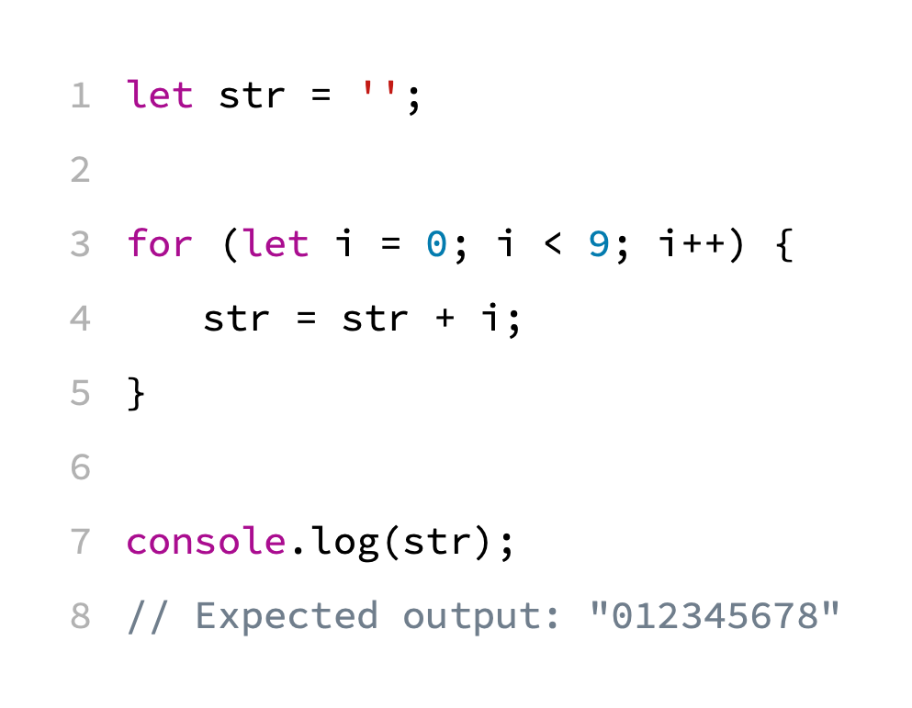
Loops: for

Slide 26
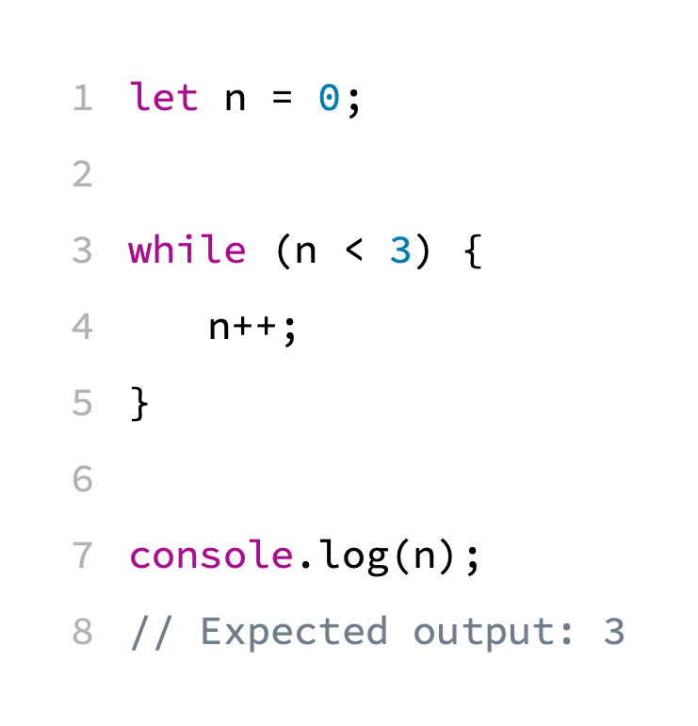
Loops: while

Slide 27
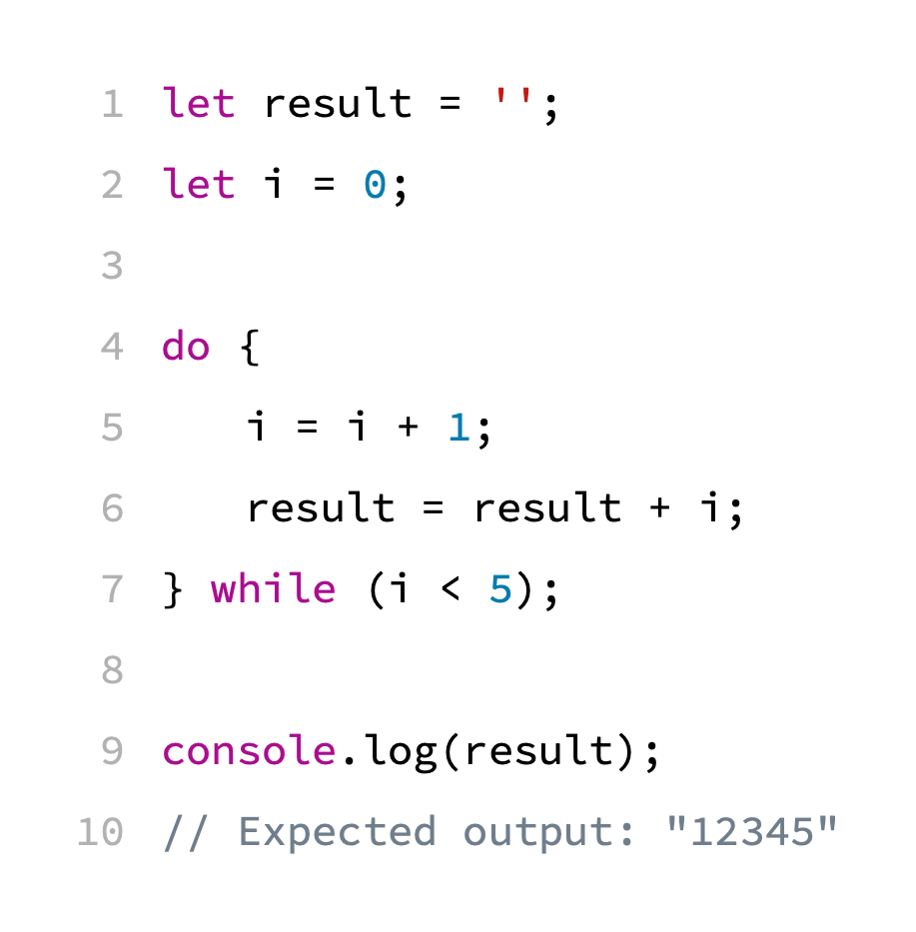
Loops: do … while

Slide 28
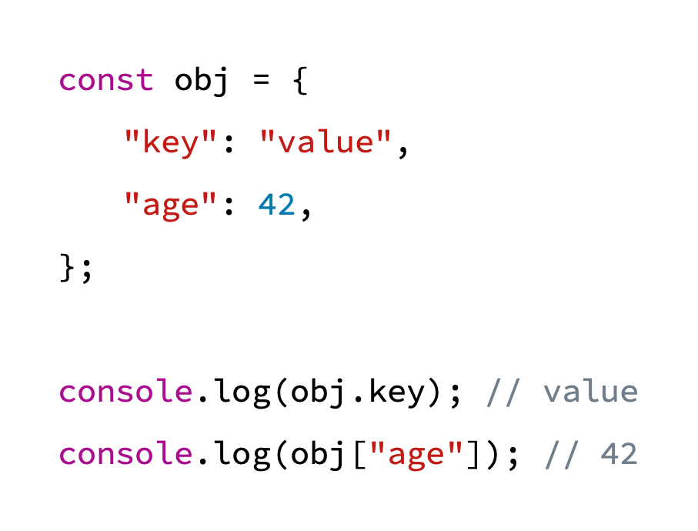
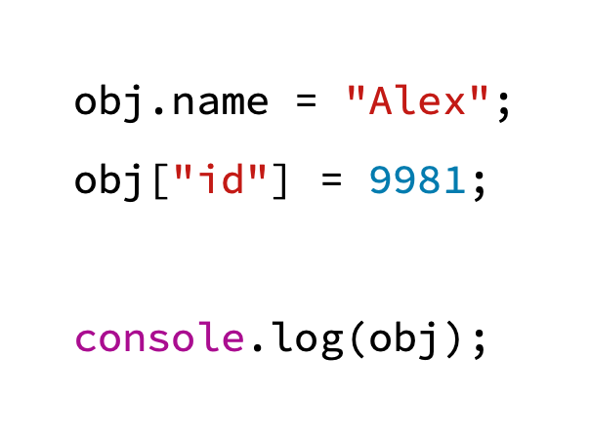
Objects

Slide 29
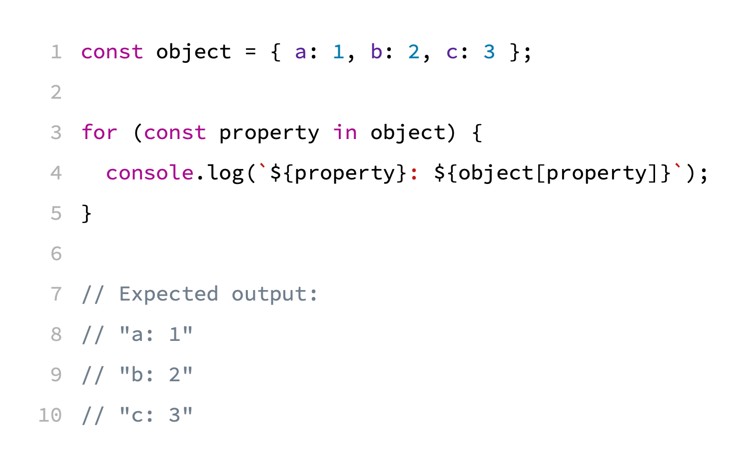
Loops: for … in

Slide 30
Arrays
Javascript arrays are resizable and can contain a mix of different data types
Javascript arrays are not associative arrays
Javascript arrays are zero-indexed

Slide 31
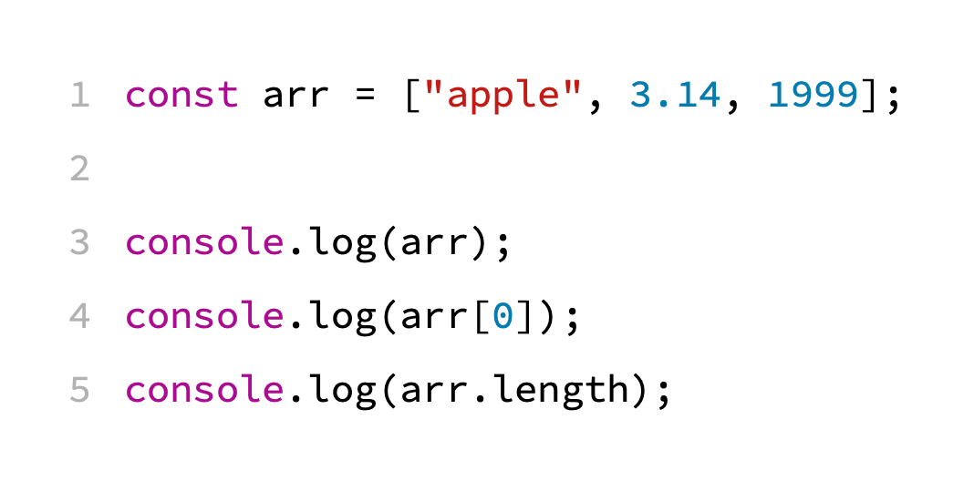

Slide 32
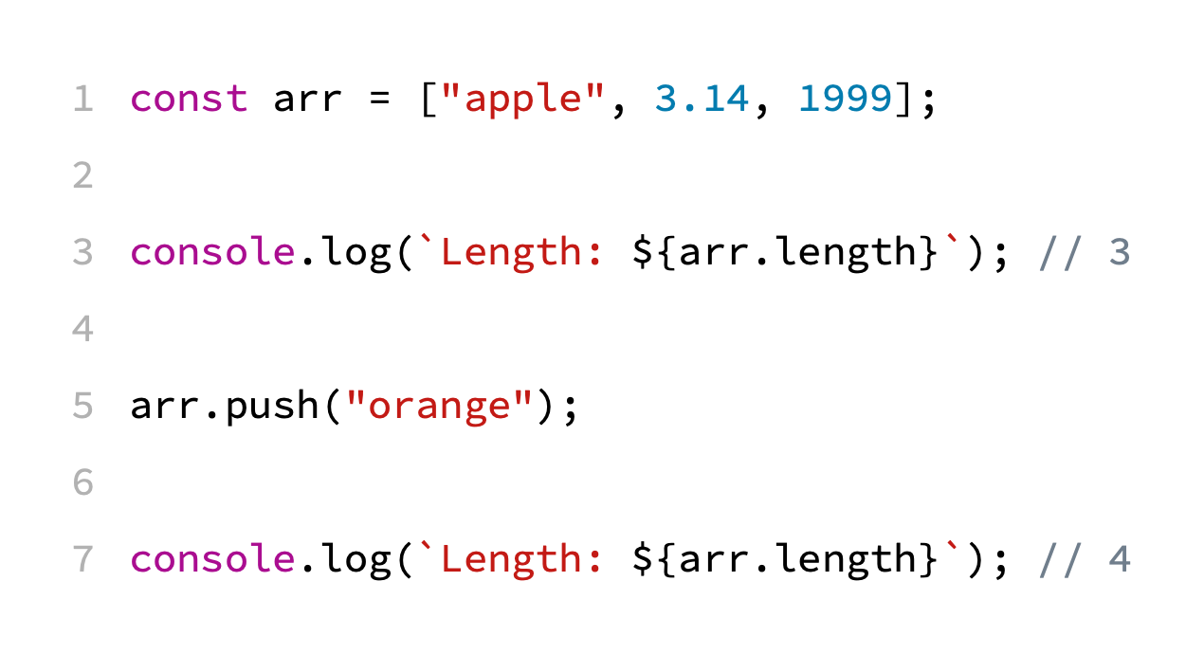

Slide 33
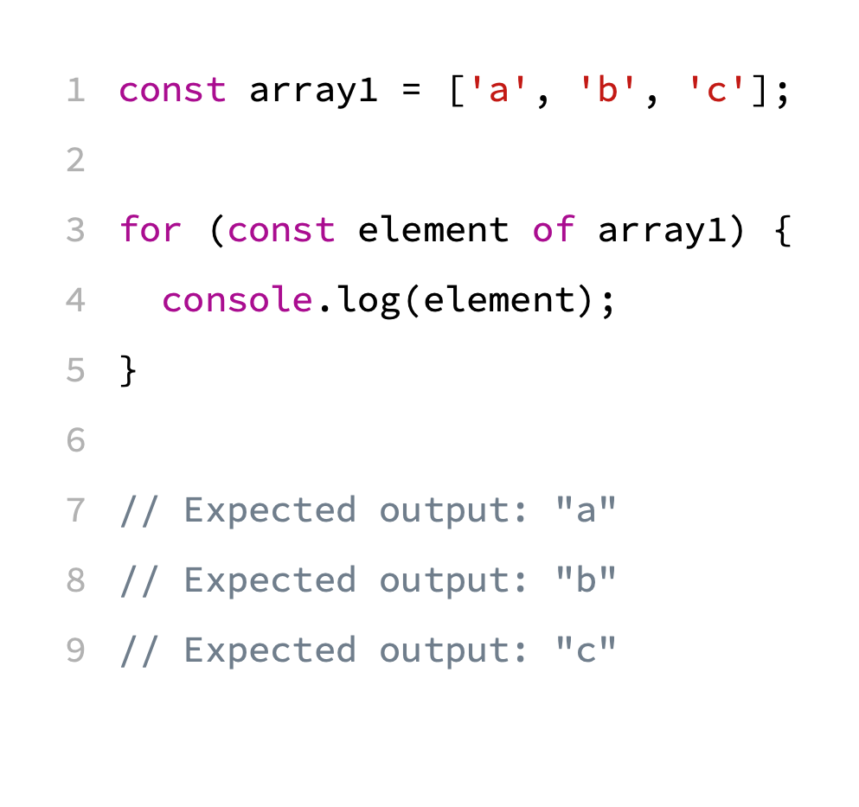
Loops: for … of

Slide 34
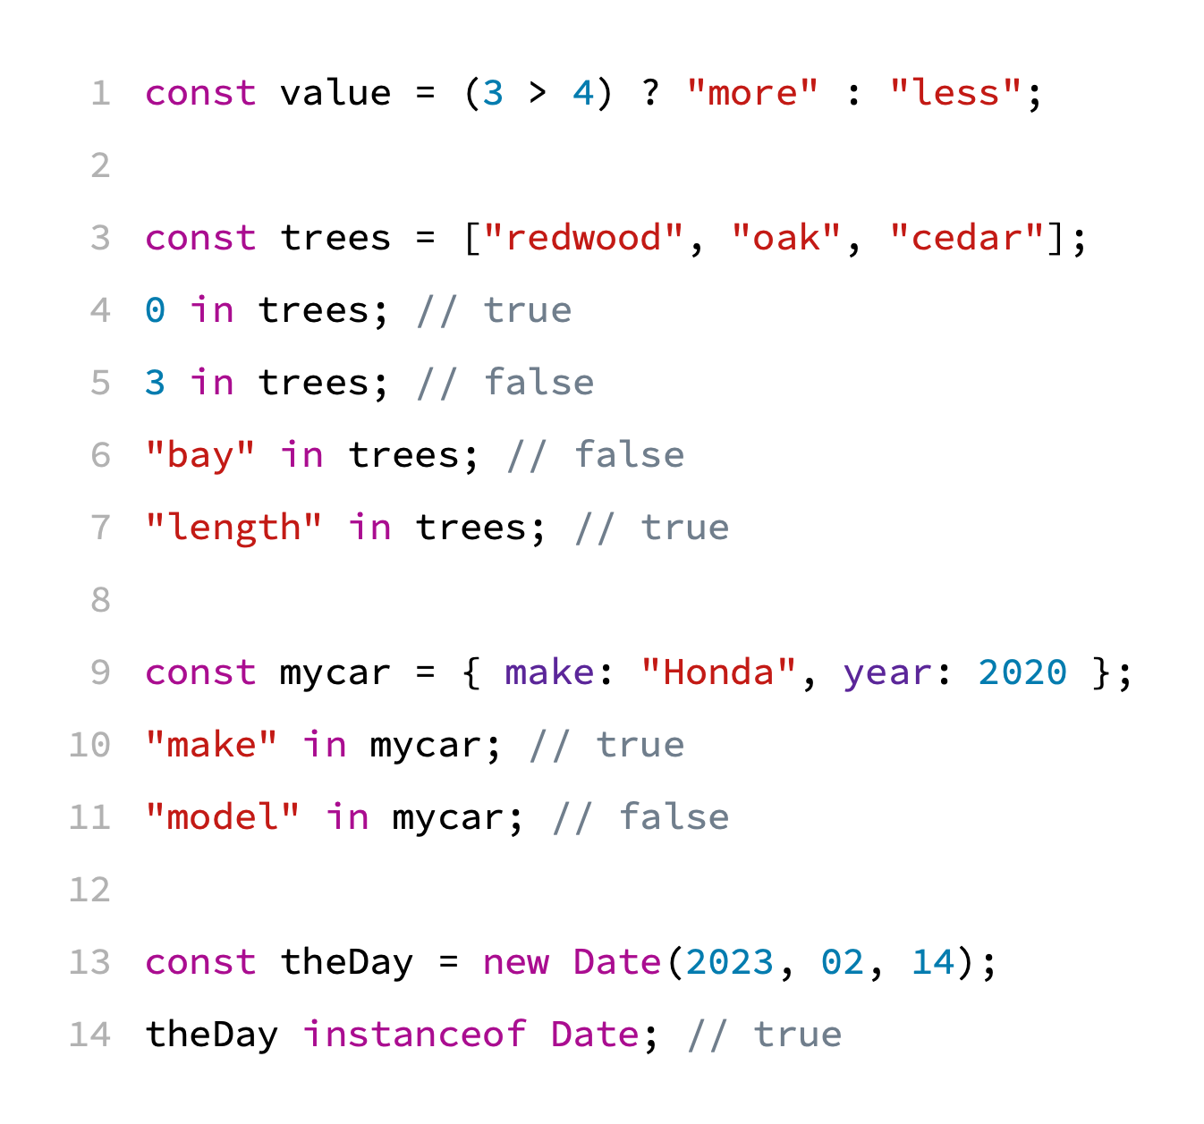
Operators
Conditional (ternary) operators
If condition is true, the operator has the value of val1. Otherwise, it has the value of val2.
Relational operators
in
instanceof

Slide 35
Exercise 2
This code does not execute properly. Try to figure out why and fix it.
https://jsfiddle.net/uxvnqdze/

Slide 36
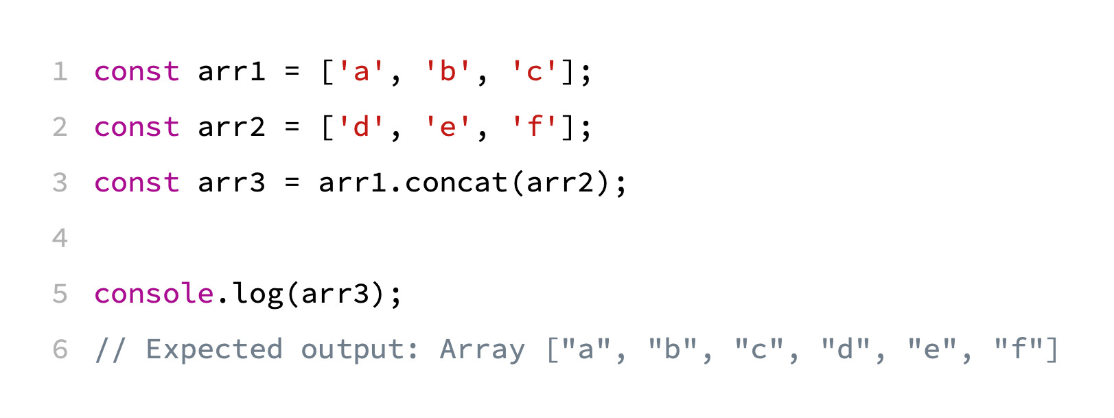
Arrays: concat

Slide 37
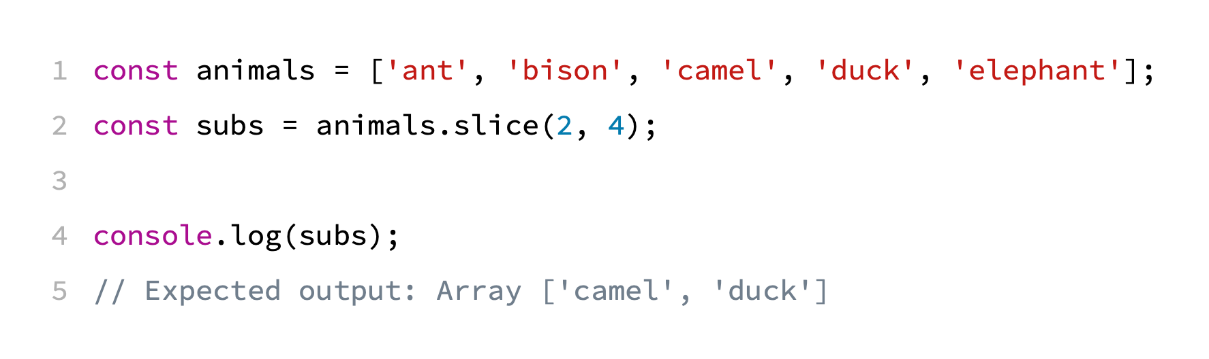
Arrays: slice

Slide 38
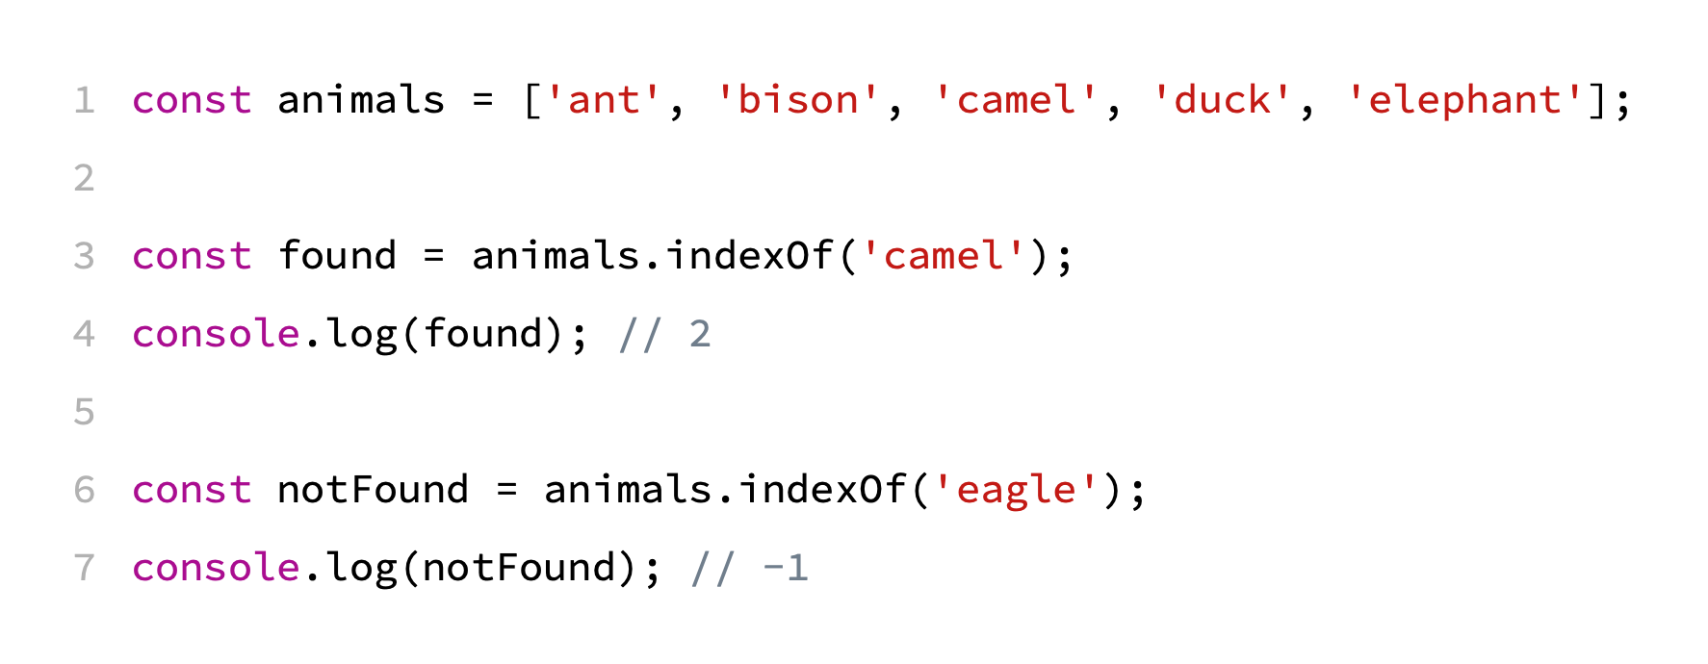
Arrays: indexOf

Slide 39
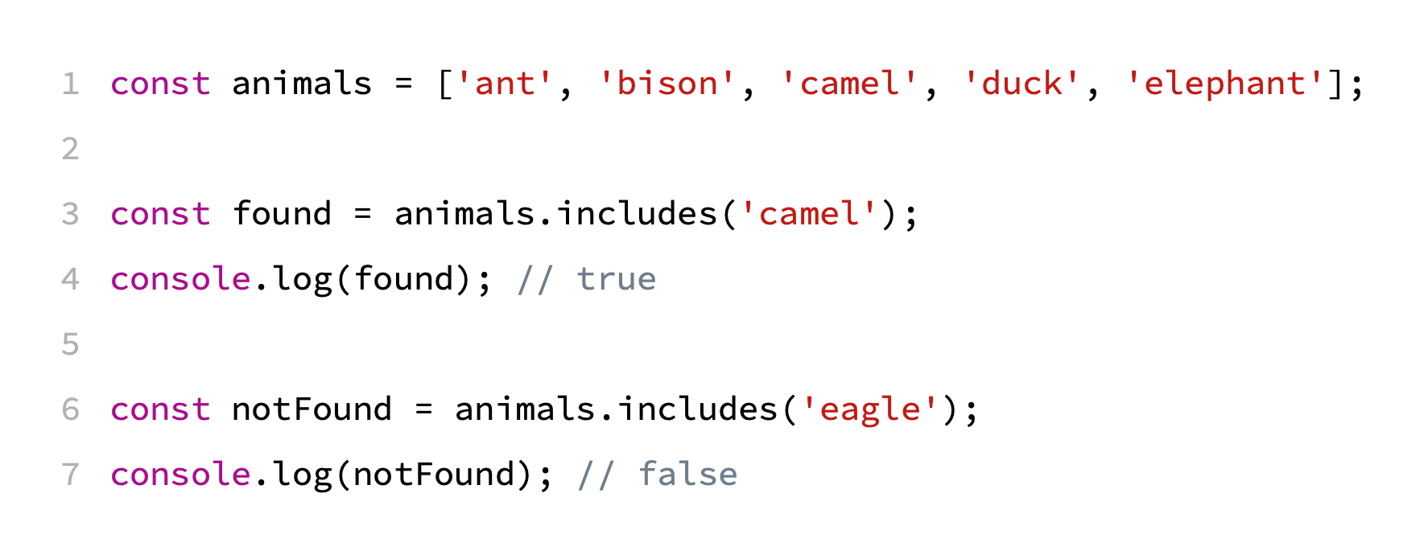
Arrays: includes

Slide 40
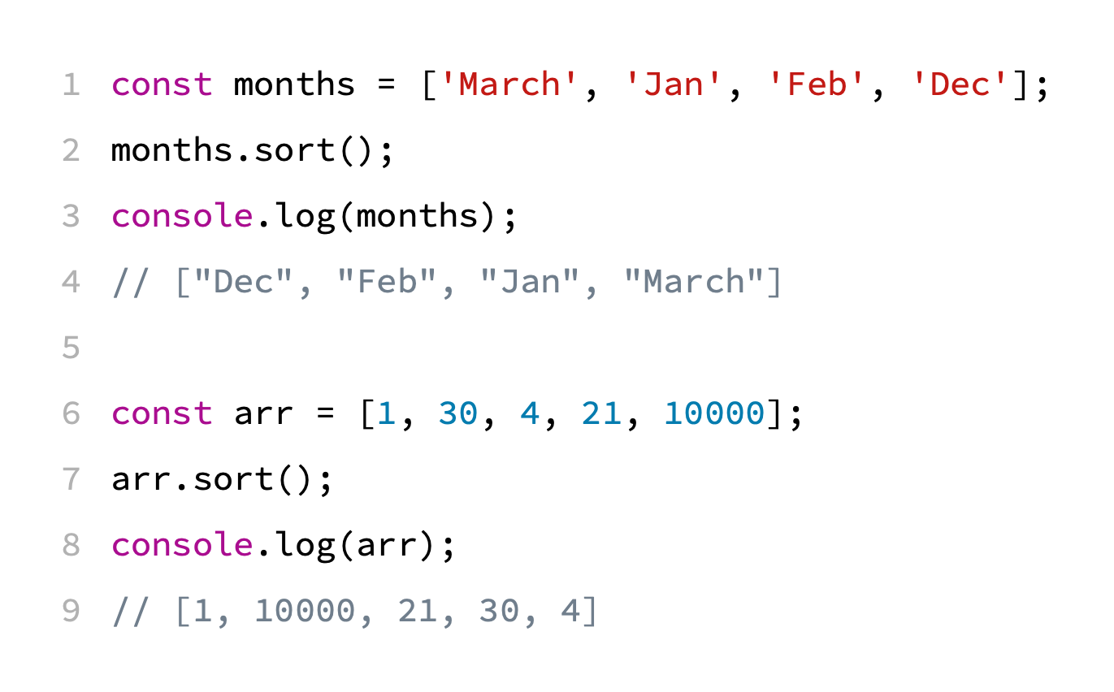
Arrays: sort
The default sort order is ascending, built upon converting the elements into strings

Slide 41
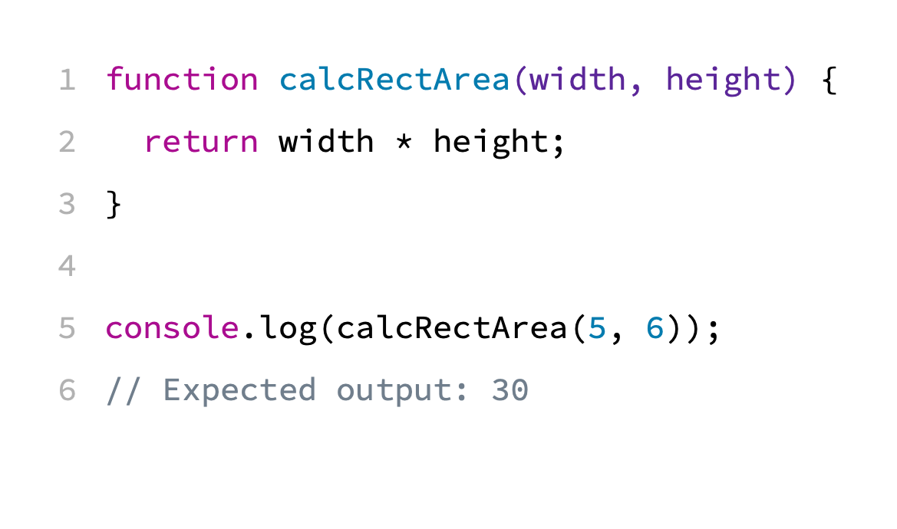
Functions

Slide 42
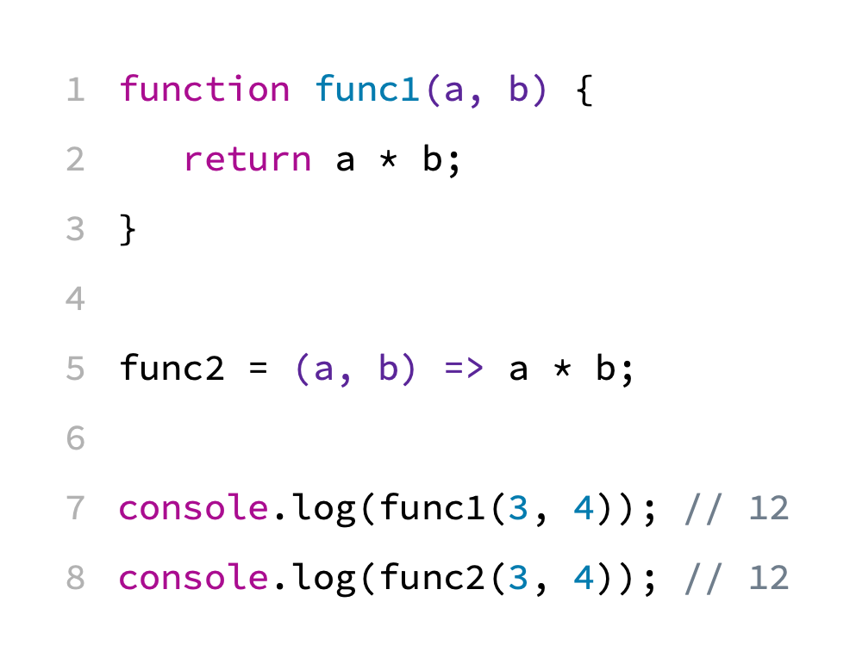
Arrow Functions

Slide 43
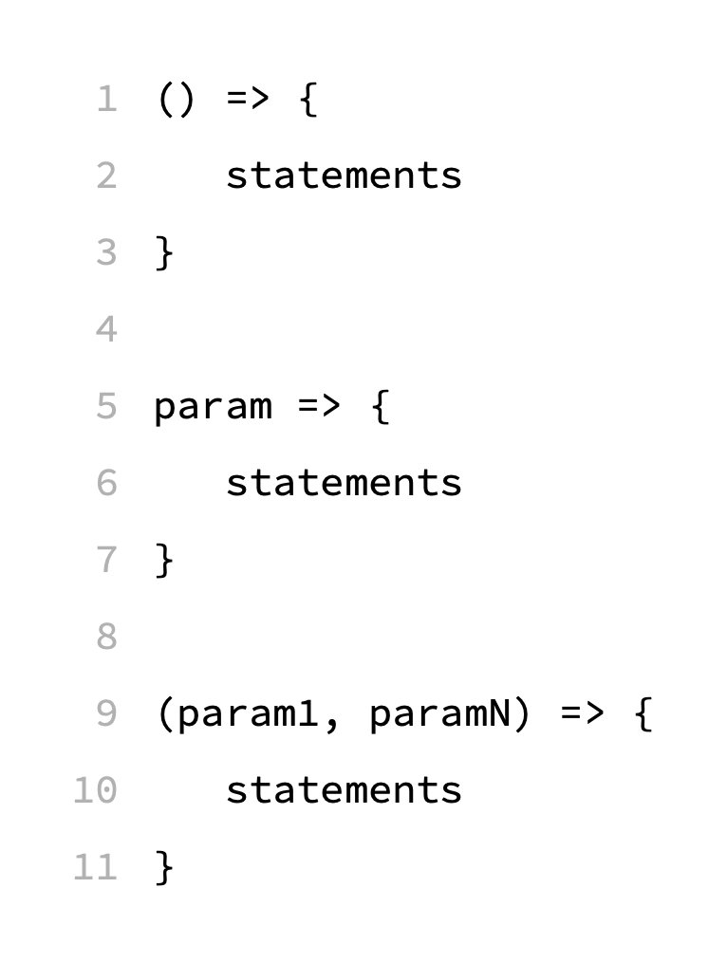
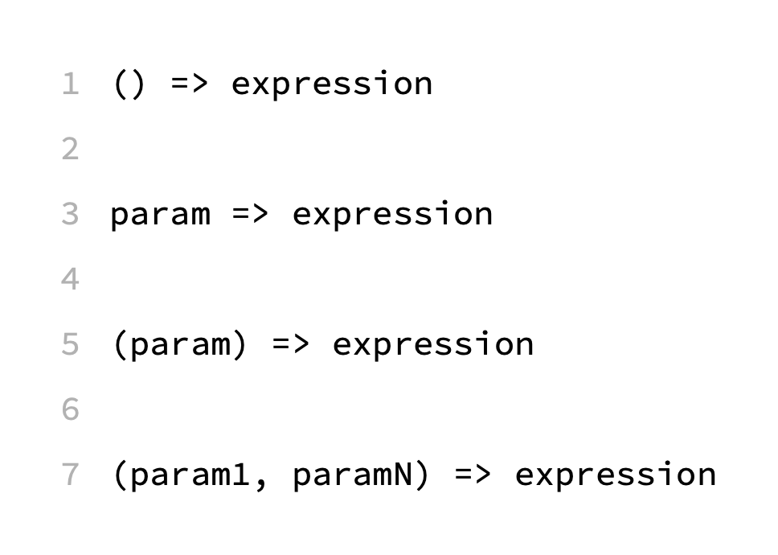
Arrow Functions - Syntax

Slide 44
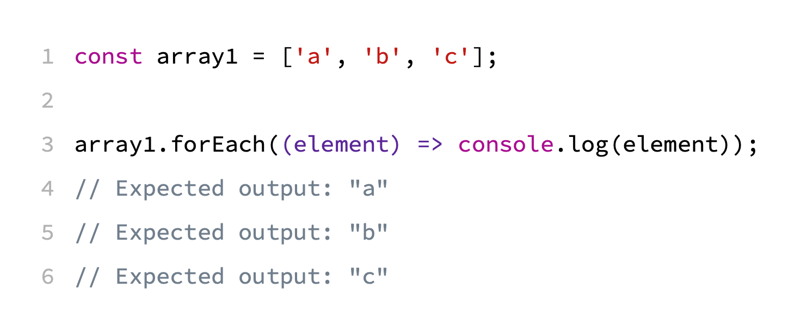
Arrays: forEach

Slide 45
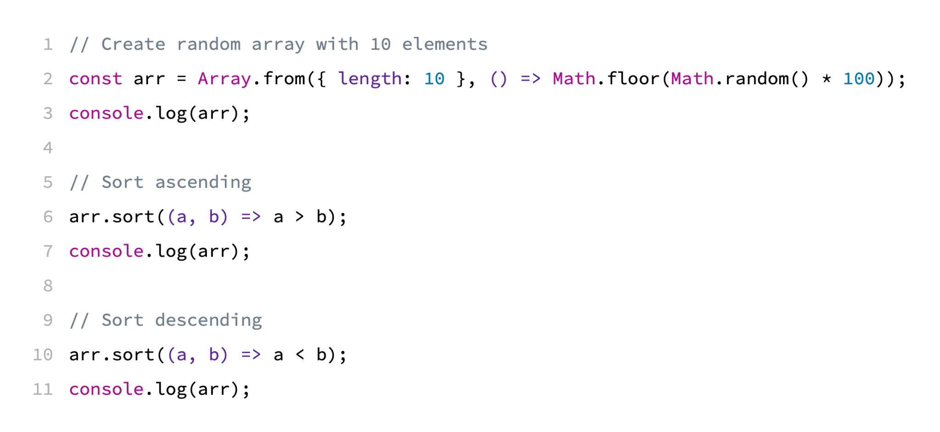
Arrays: sort
https://jsfiddle.net/cgmw6qe2/

Slide 46
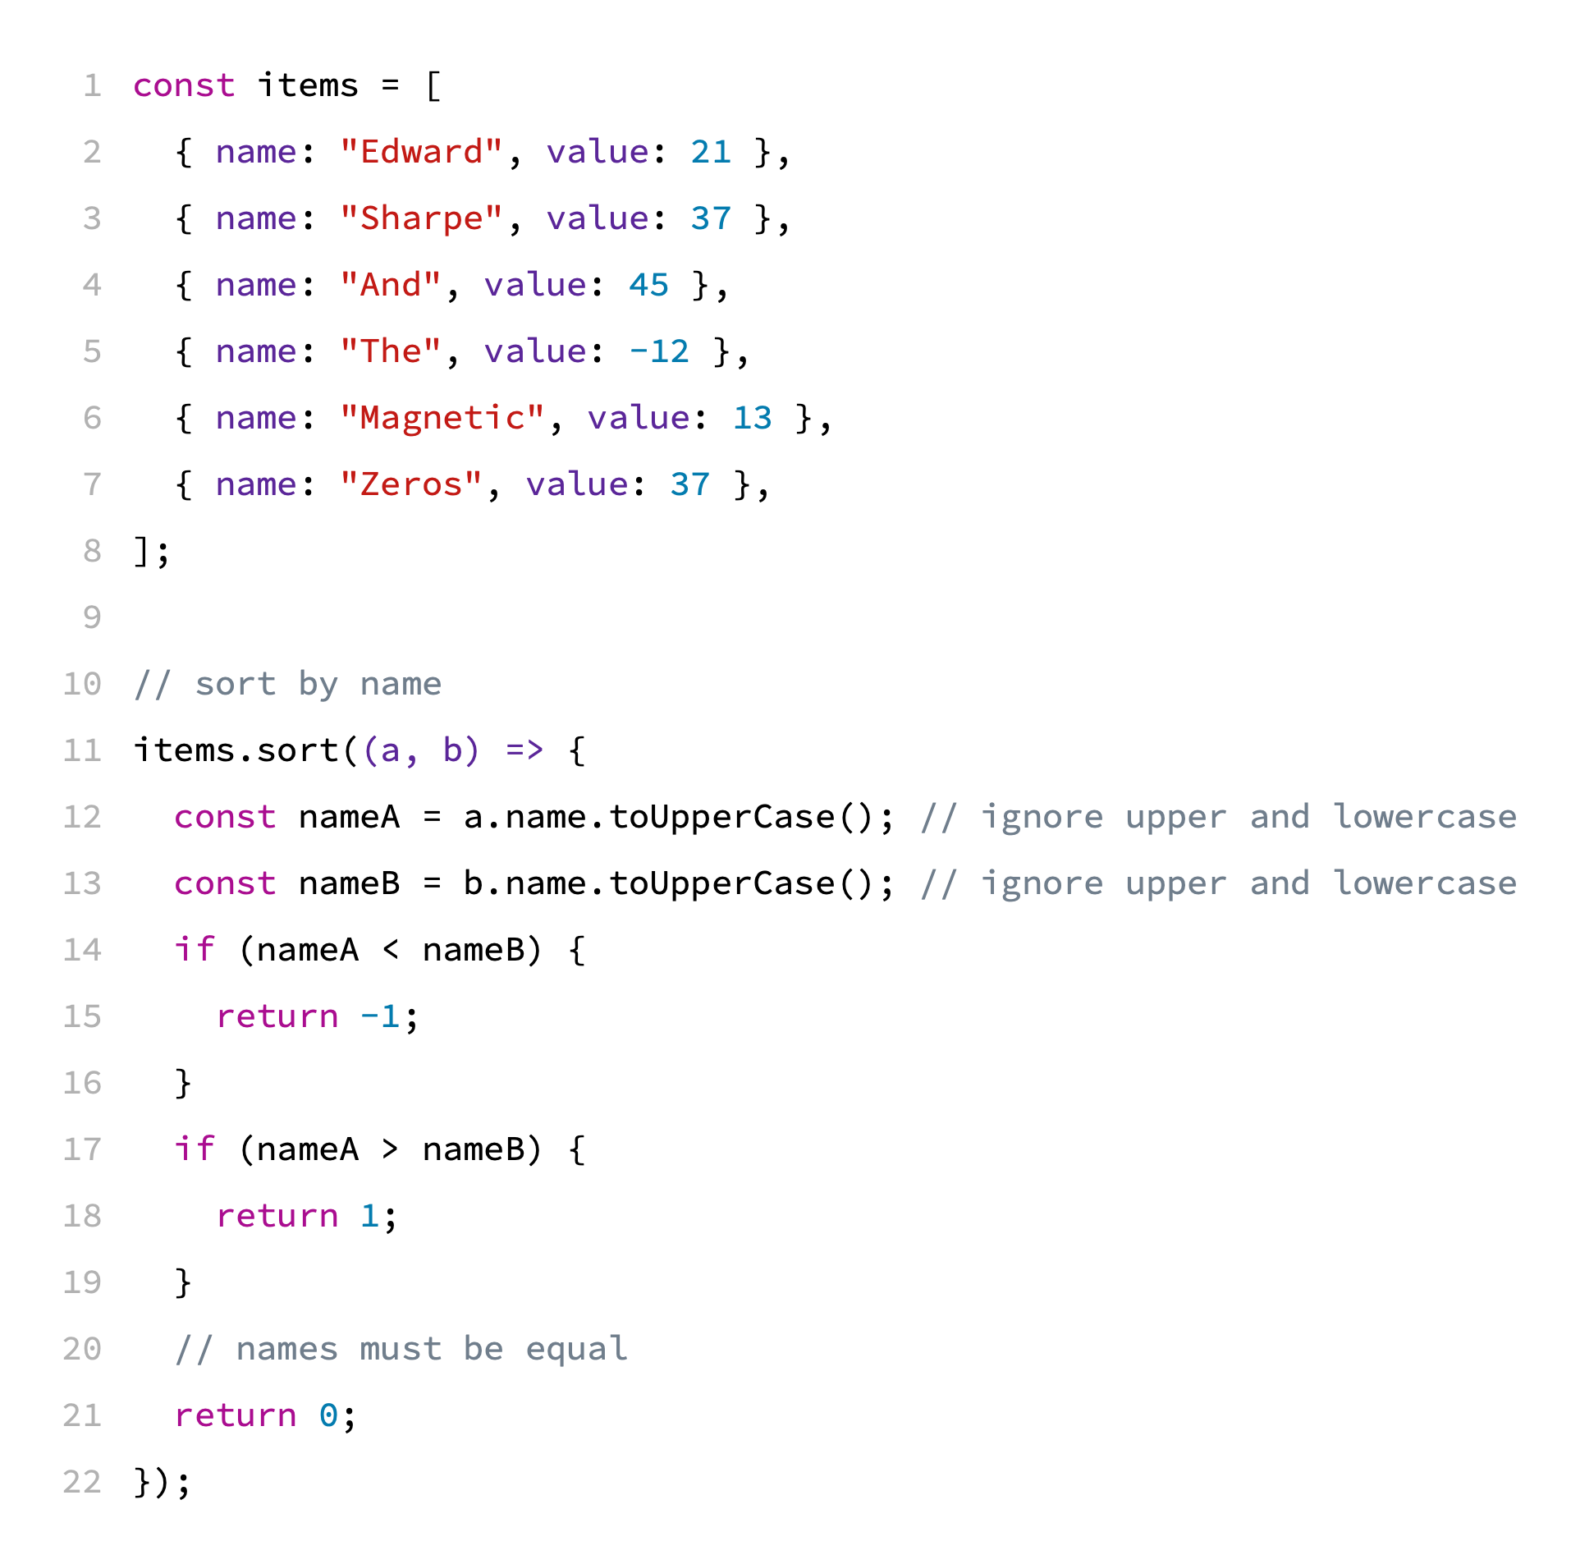
Arrays: sort with custom comparison function
Array of objects can be sorted by comparing the value of one of their properties.
https://jsfiddle.net/9x6o4tsp/

Slide 47
Exercise 3
Given an example on how to use Array.map(...) method in Javascript, write a code to create a new array that is populated with only odd-values from the original array.
https://jsfiddle.net/1p23y6h7/

Slide 48
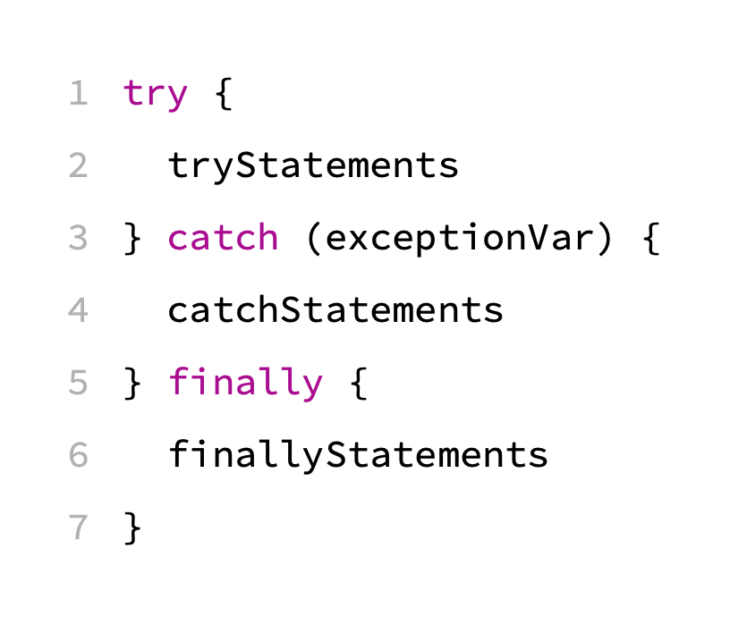
Error Handling

Slide 49
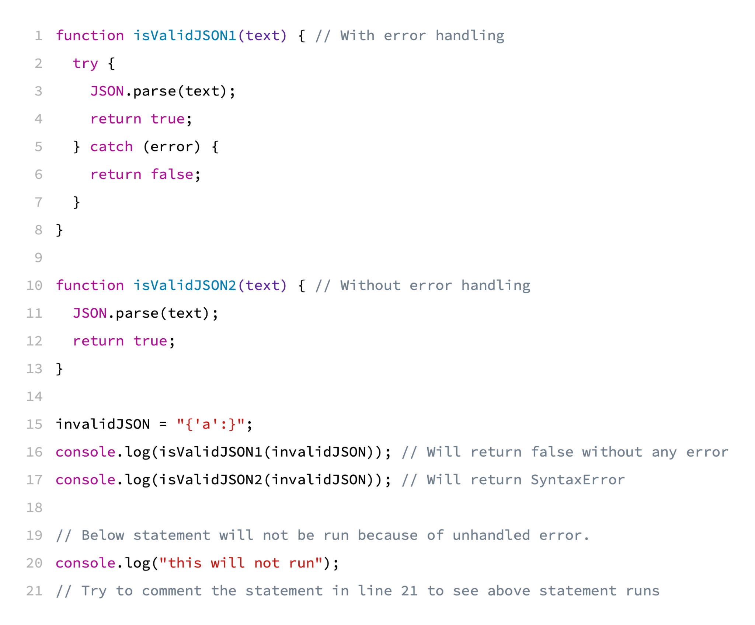
Error Handling
Why the errors should be handled?
https://jsfiddle.net/3ovLp81f/

Slide 50
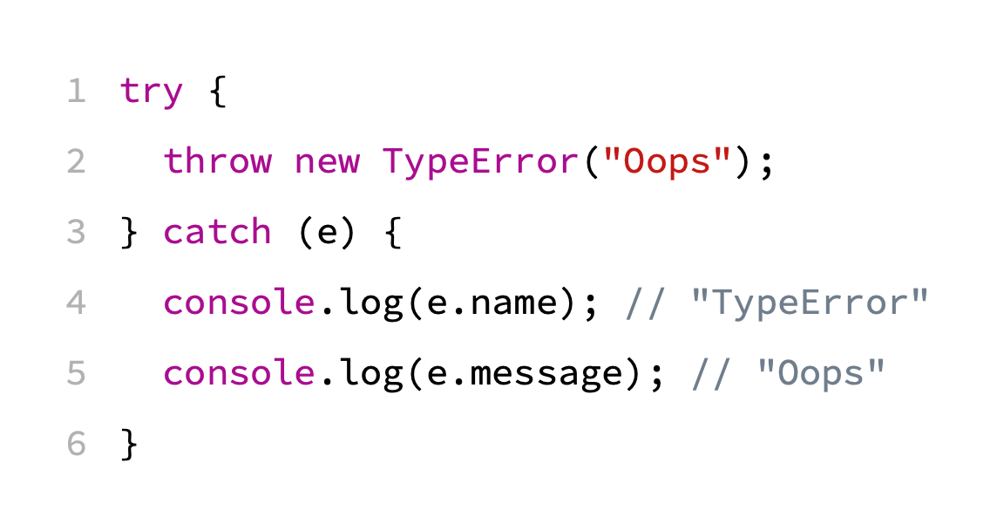
Error Handling: throw

Slide 51
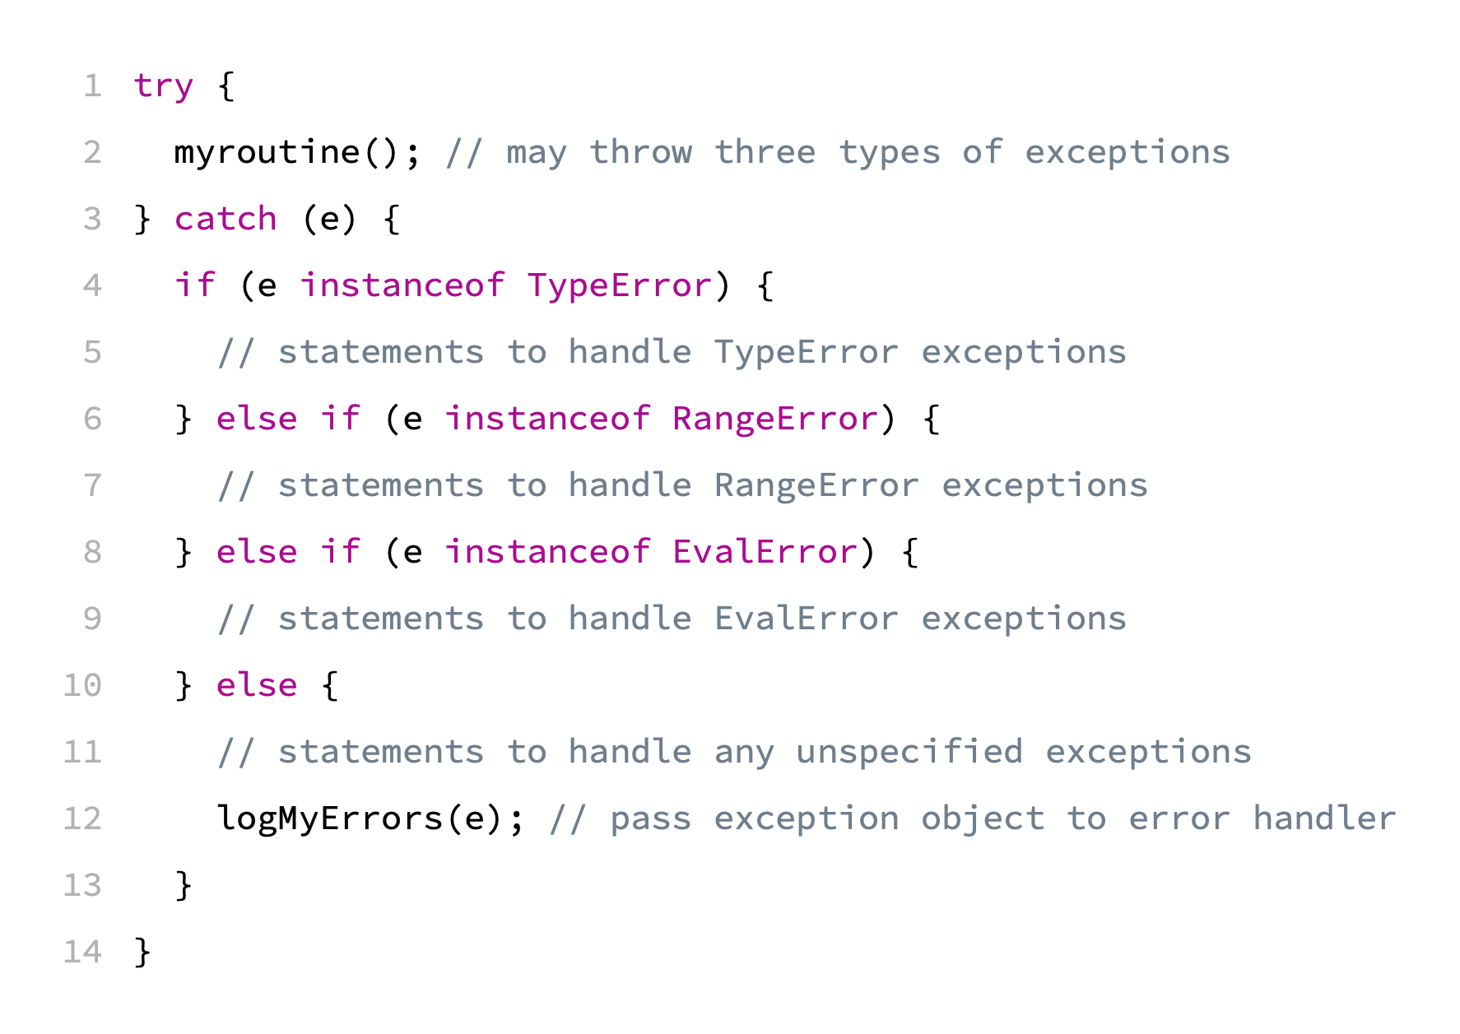
Error Handling - Conditional catch blocks
List of errors: https://developer.mozilla.org/en-US/docs/Web/JavaScript/Reference/Errors

Slide 52
Error Handling
Enters the finally block:
Immediately after the try block finishes normally (and no exceptions were thrown)
Immediately after the catch block finishes normally
Immediately before a control-flow statement (return, throw, break, continue) is executed in the try or catch block

Slide 53
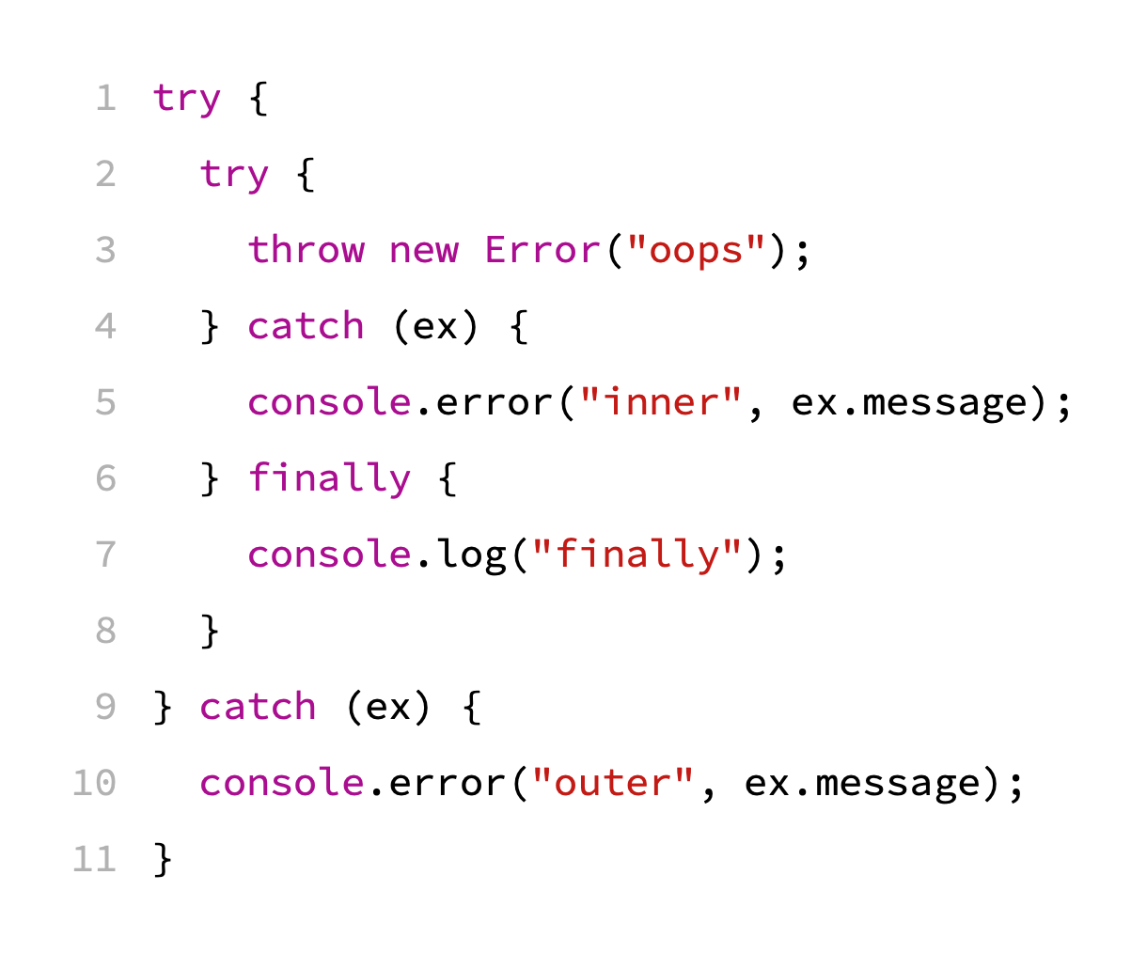
Exercise 4 - What is the output?

Slide 54
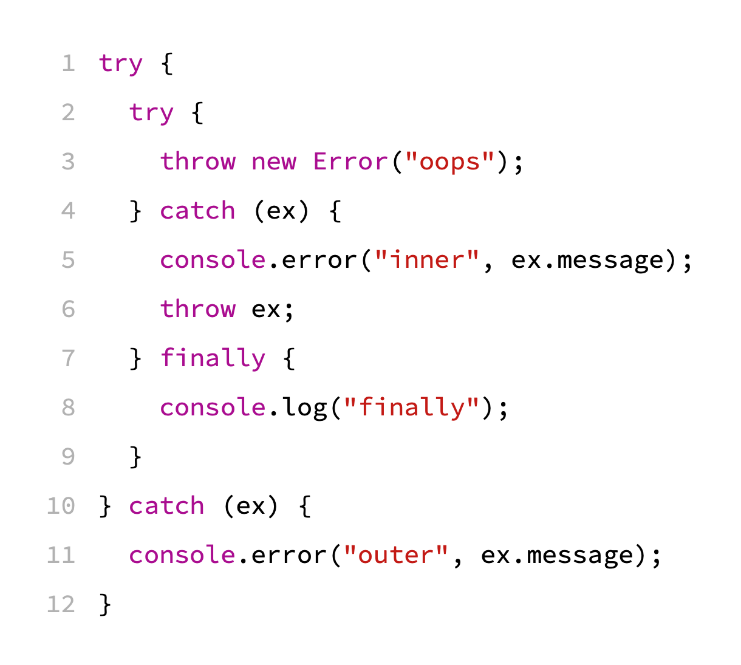
Exercise 5 - What is the output?

Slide 55
Classes
Classes are a template for creating objects.
They encapsulate data with code to work on that data.

Slide 56
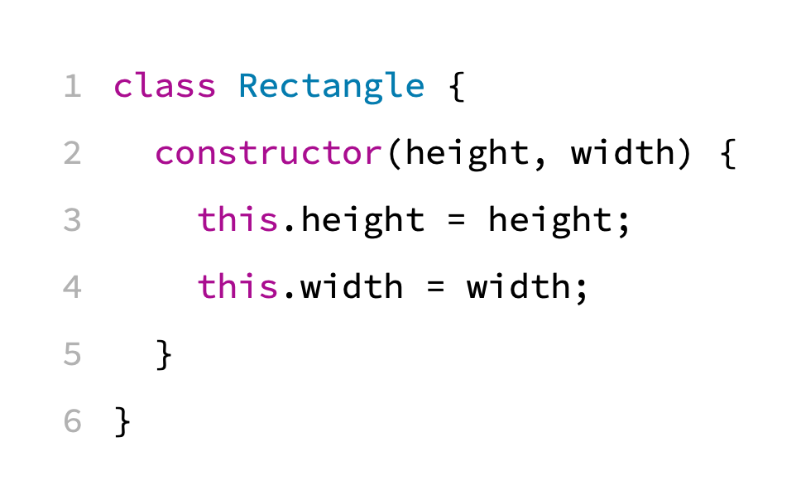
Classes - Constructor

Slide 57
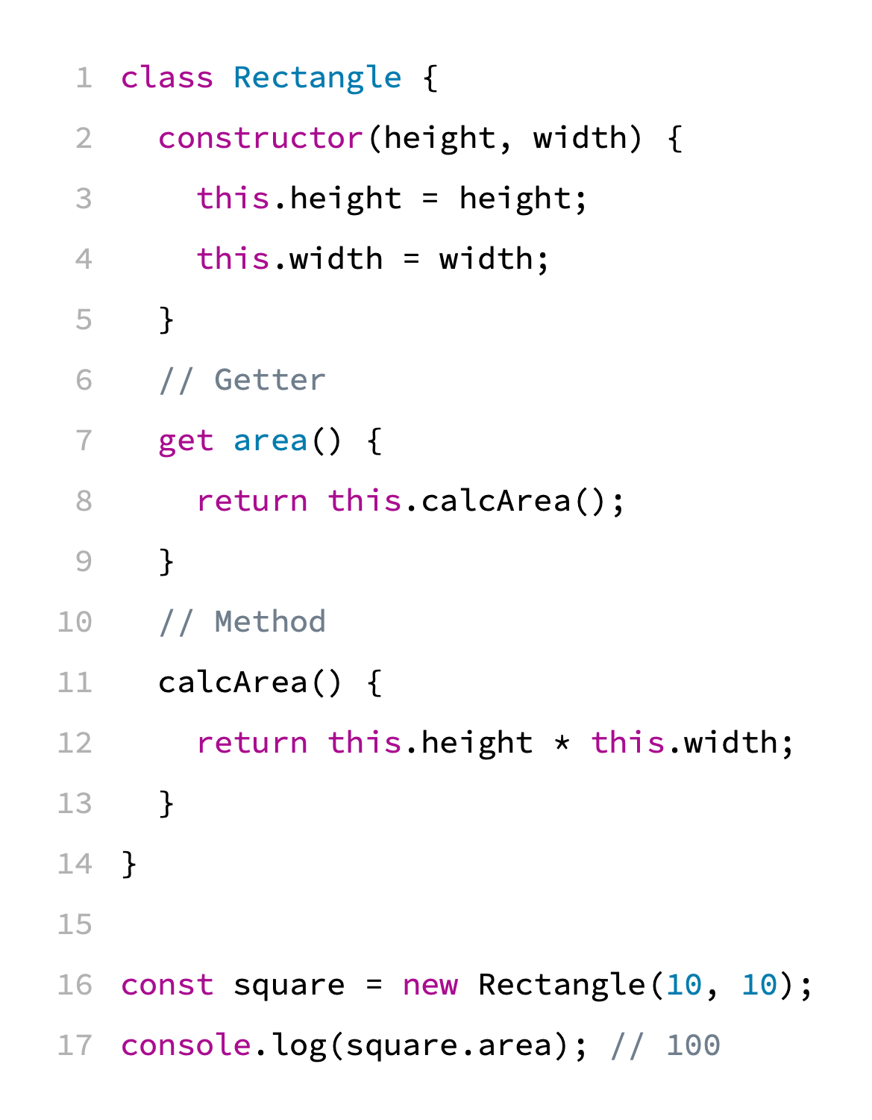
Classes - Getter and Methods
https://jsfiddle.net/foszhwg5/

Slide 58
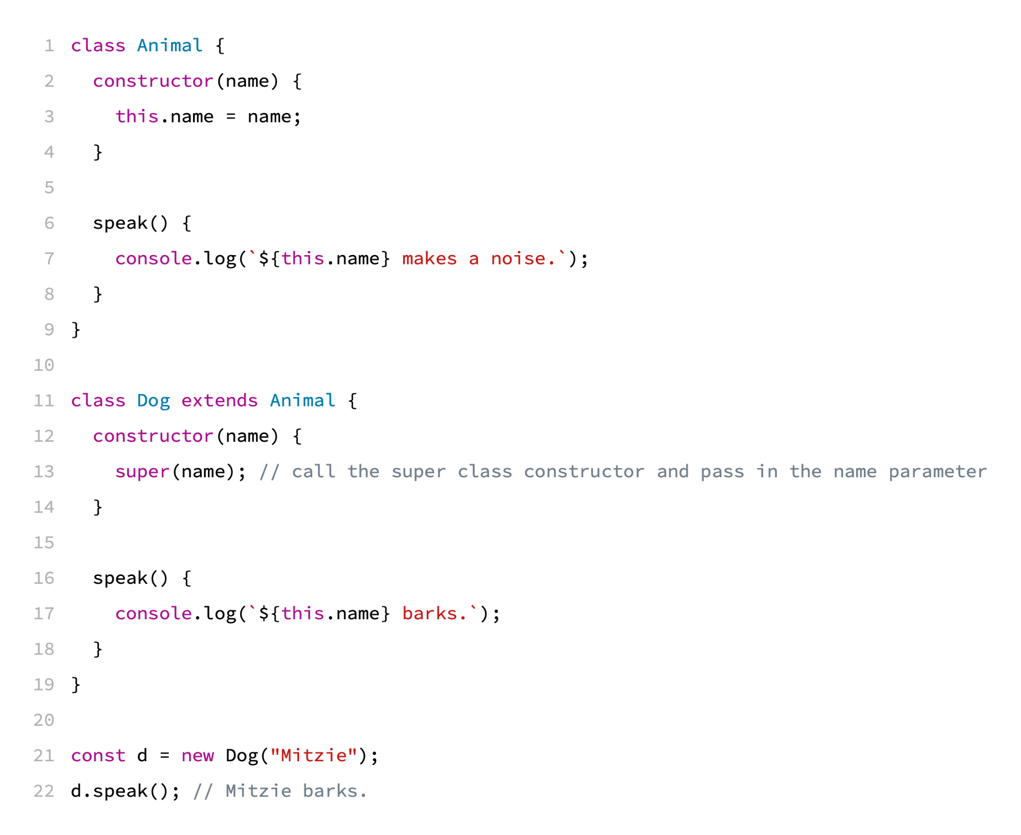
Classes - Inheritance
https://jsfiddle.net/b4rgqvoc/

